Slide 1

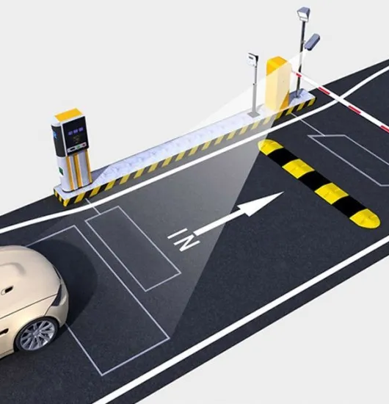
License PLATE RECOGNITION SYSTEM
BY :
Ahmed Balhareth
Mohammed Alghamdi
Zed Ali

Slide 2
AIM
With this project we aim to create a License Plate Recognition System which can identify the License Plate number of the vehicles on the road. This system can be expanded on further and be used for various other systems e.g. a parking system, vehicle tracking in a metropolitan city etc.

Slide 3
METHODOLOGY
PLATE DETECTION
CHARACTER EXTRACTION
CHARACTER RECOGNITION

Slide 4
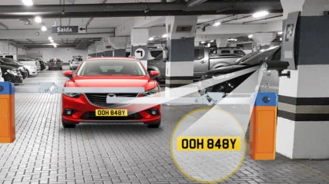
Plate Recognition

Slide 5
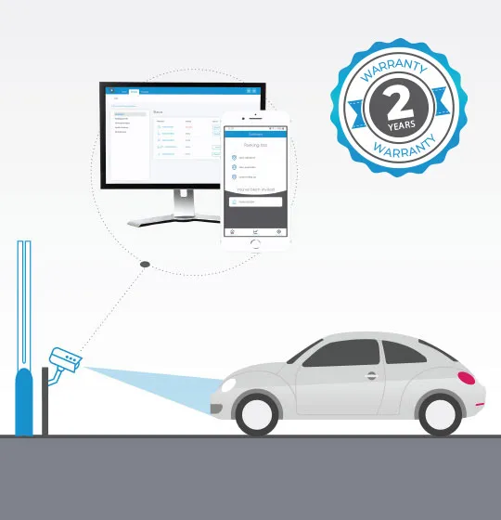
Heuristic Method
In the heuristic method, a few assumptions are made to extract the image containing the number plate. These assumptions are made while considering input pictures and the camera positioning.
by highways agencies.

Slide 6
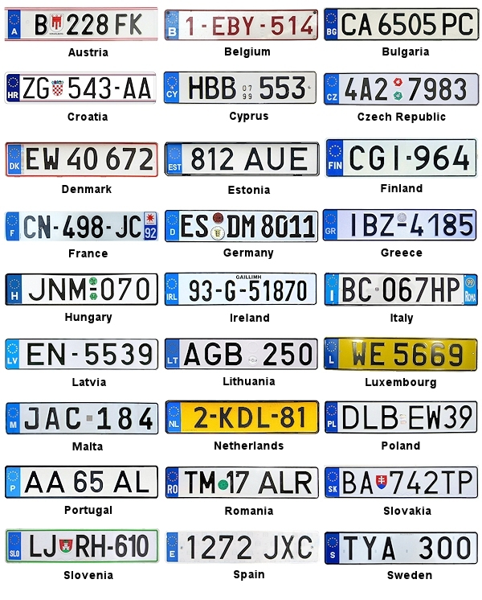
The height of the plate is 5 to 20 percent of the image height.
The width of the plate is 15 to 60 percent of the image width.
Plate height is greater than 20 percent of plate width.

Slide 7
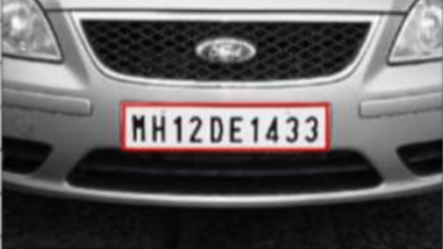
Take the image as input.
Converts the image to grayscale
Converts grayscale to binary using OTSU threshold method.
Label all the connected components in the binary image.
Selected corresponding bounding-boxes
Select the listed bounding boxes

Slide 8
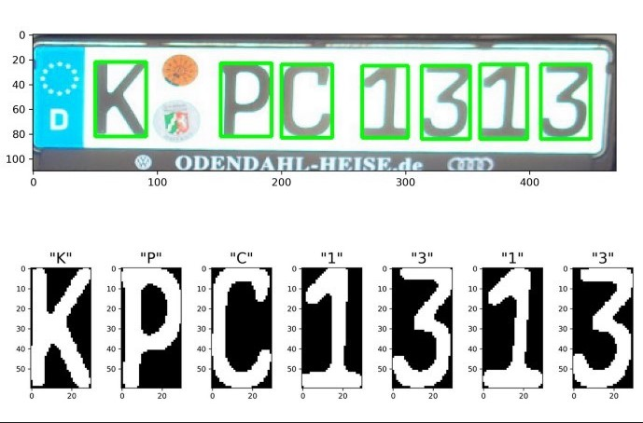
Edge Detection
Edge detection is an image processing technique for finding the boundaries of objects within images. It works by detecting discontinuities in brightness. Edge detection is used for image segmentation and data extraction in areas such as image processing, computer vision, and machine vision.

Slide 9
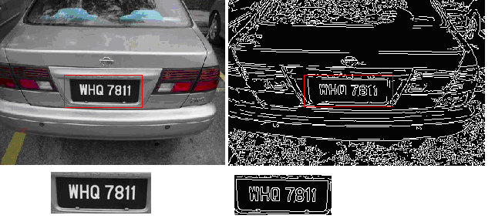
First, we take the image and read it as a NumPy array. and convert images to grayscale.
The grayscale image is that it has only 1 layer w, hence the processing speed is greatly increased.
Removing unwanted noise from the image.
Edge detection as the edges are sufficient to identify the number plate and the text (numbers and alphabets) inside it.

Slide 10

CHARACTER EXTRACTION

Slide 11
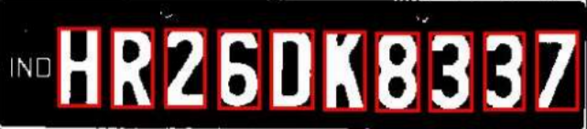
CHARACTER SEGMENTATION:
After the license plate is recognized, we need to perform character segmentation. In character segmentation, we identify each character present on the license number plate and later these characters are used for character recognition. For character segmentation, there are various methods available to do this like using contours, projection, transforms, etc. We have done the following:

Slide 12
Assumptions
The plate contains only 10 characters.
The height of each character is within 35%-90% of the total plate height.
The width of each character is within 2%-10% of the total plate width.
Steps
Labels all the connected components inside the plate area selected before. then selects a bounding box to represent the connected components.
These selected boxes are checked against the assumption made for characters.
At the end, assumption number 1 is checked, and the corresponding segmented set of characters is returned.

Slide 13
Using Tesseract (Open-Source OCR)
Tesseract is an open-source OCR (optical character recognition) that can work on more than 100 languages and find the text from the input image. It was the first OCR engine to be able to handle black and white texts efficiently.
First, it performs connected component analysis in which it stores the outlines of the connected components.
Next, it creates Blobs by gathering the outlines together.
These blobs are organized in the form of text lines and then analyzed for a fixed proportion of text. This proportional text is divided into words.
Next, the recognition of characters takes place using an adaptive classifier.

Slide 14
Python library for Extraction
All this is wrapped into the python library “pytesseract” which is imported when we want to use the Tesseract OCR. Once we have our license plate recognized, extraction of license plate number from the plate image is done using pytesseract image_to_string () function.

Slide 15
CHARACTER RECOGNITION

Slide 16
Character Recognition :
Create an OCR (Optical Character Recognition). For this, we can use either a statistical classifier or a computational classifier. We used the following:
Support Vector Machine Classifier
The main objective of the support vector machine algorithm is to find a hyperplane in N-dimensional space (N — the number of features) that uniquely classifies the information points into different predefined groups or segments
Our objective is to seek out a plane that has the most margin, i.e., the most distance between data points of both classes.
- To classify each alphanumeric character

Slide 17
Support Vector Machine Classifier
We get the binary image of each alphanumeric character by using the Otsu threshold value. The training set consists of 20pX20p images of all alphanumeric characters. We are using a sci-kit learn package for implementing our model and cross-validation with four folds (that is 3/4th of the dataset is used for training and 1/4th is used for testing). Once the model is trained it is saved for our later use i.e. to make predictions on the character segmented image of license plate.

Slide 18
CONCLUSION

Slide 19
In the first method, we have used the edge feature detection for plate recognition and Tesseract for character segmentation and recognition.
In the second method, we have used the Heuristic method for plate recognition and character segmentation and SVM classifiers to recognize each segmented character.

